Slide 1

STATISTICAL ARBITRAGE MODEL
FOR NATIONAL STOCK EXCHANGE (NSE) DATA

Slide 2
STEPS OF PROCEDURE
Data
Pre-processing
Classification
Prediction

Slide 3
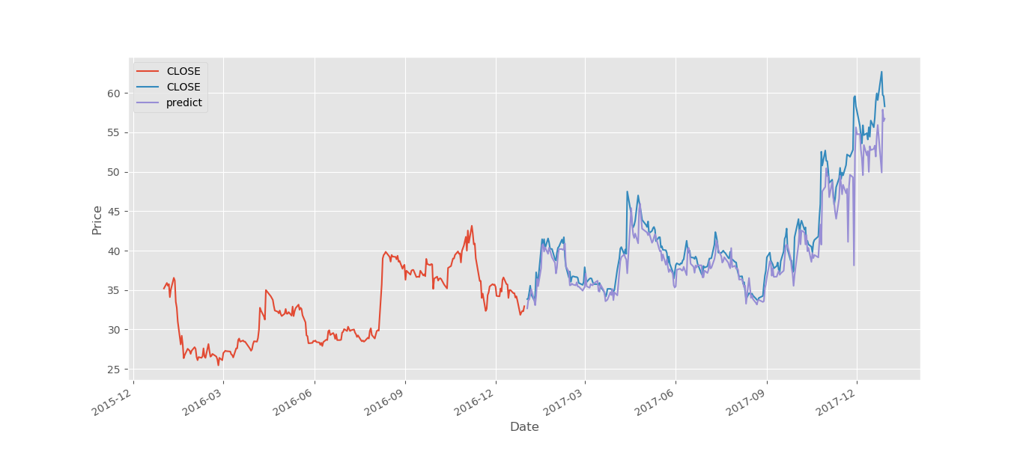
Selecting Features and labels:
For the NSE stock exchange data,
Features are ['OPEN', 'HIGH', 'LOW’, 'TOTTRDQTY', 'Date', 'PREVCLOSE', 'TOTTRDVAL', 'TOTALTRADES’]
And the target variable is [‘CLOSE’] and the plot is
We introduce a new parameter which calculate High low %change i.e., [‘HC_PCT’] which acts as common feature to
[‘HIGH’] and [‘LOW’]
HIGH
LOW

Slide 4
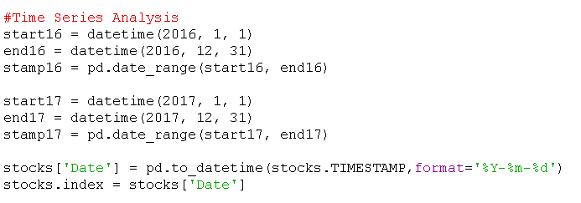
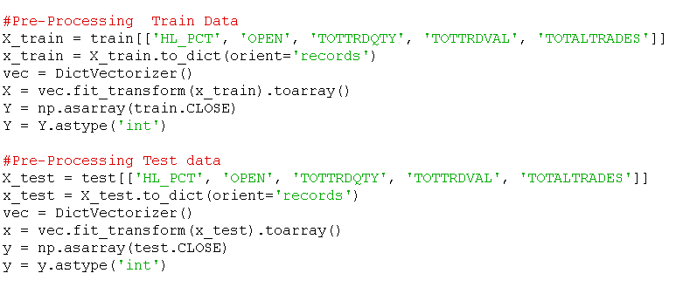
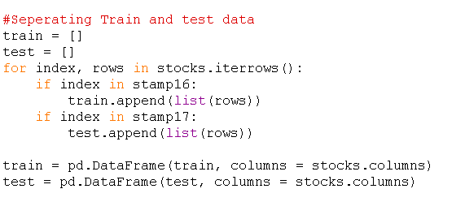
Data Pre-Processing
TIME SERIES ANALYSIS:
Extracting data from dictionaries:
SPLITTING TRAIN & TEST DATA:
“Splitting on basis of time series analysis,
2016 reports as training data and
2017 reports as testing data.”

Slide 5
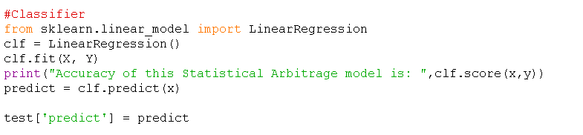
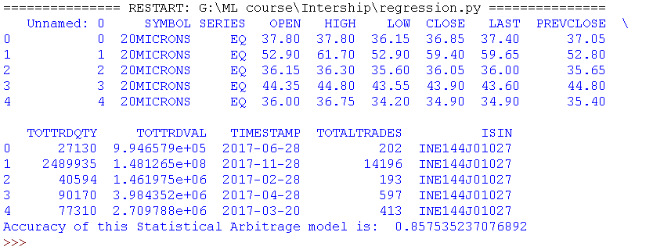
Classification:
“In statistics, linear regression is a linear approach to modelling the relationship between a scalar response (or dependent variable) and one or more explanatory variables (or independent variables). The case of one explanatory variable is called simple linear regression.”

Slide 6
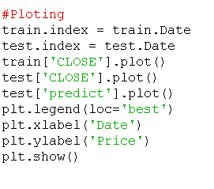
Plotting the prediction over 2017 dataset:

Slide 7


Thank You
Dannina Harsha Sai Manoj Kumar
Thank You

